Slide 1
Announcements
Keeping Up with Challenges
Sharing Flags
HITCON
Class Change of Location

Slide 2
Stack-Based Exploitation

Slide 3
Exploitation
What’s the goal?
Code execution
Memory Corruption
Changing values in memory you’re not supposed to change
`cat flag.txt`

Slide 4
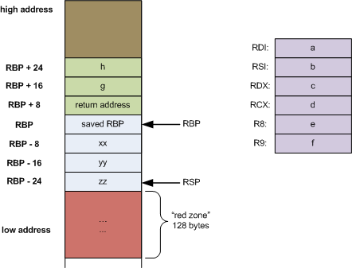
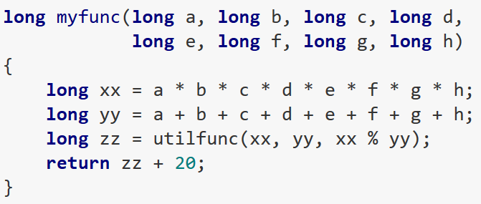
The Stack
https://eli.thegreenplace.net/2011/09/06/stack-frame-layout-on-x86-64

Slide 5
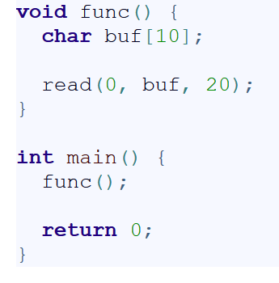
Buffer Overflow
https://www.acunetix.com/blog/web-security-zone/what-is-buffer-overflow/

Slide 6
Example!

Slide 7
Mitigation Techniques
ASLR
NX
Stack Canary

Slide 8
ASLR
?
rand()

Slide 9
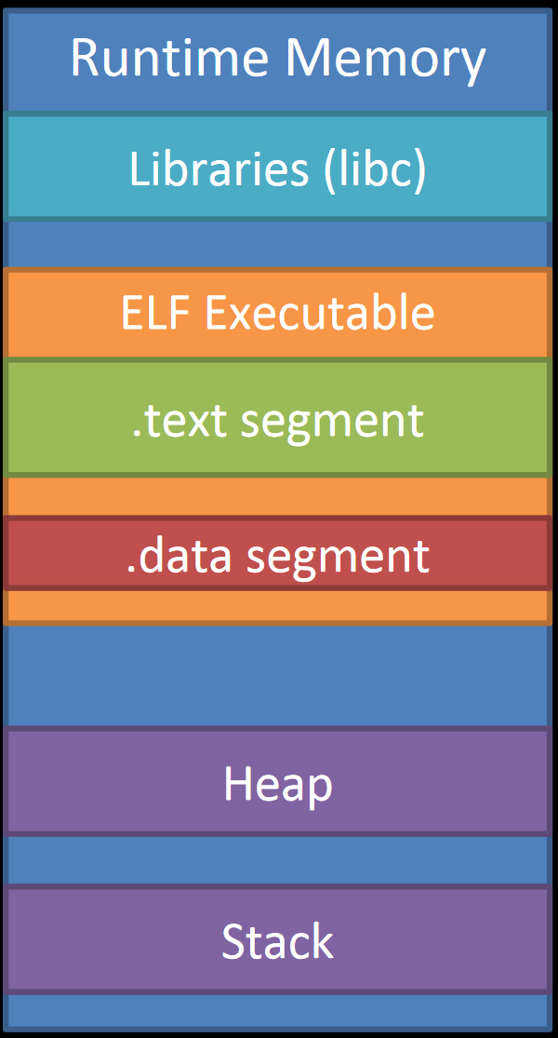
Bypassing ASLR
http://security.cs.rpi.edu/courses/binexp-spring2015/lectures/5/04_lecture.pdf

Slide 10
NX

Slide 11
From RPISEC’s MBE course

Slide 14
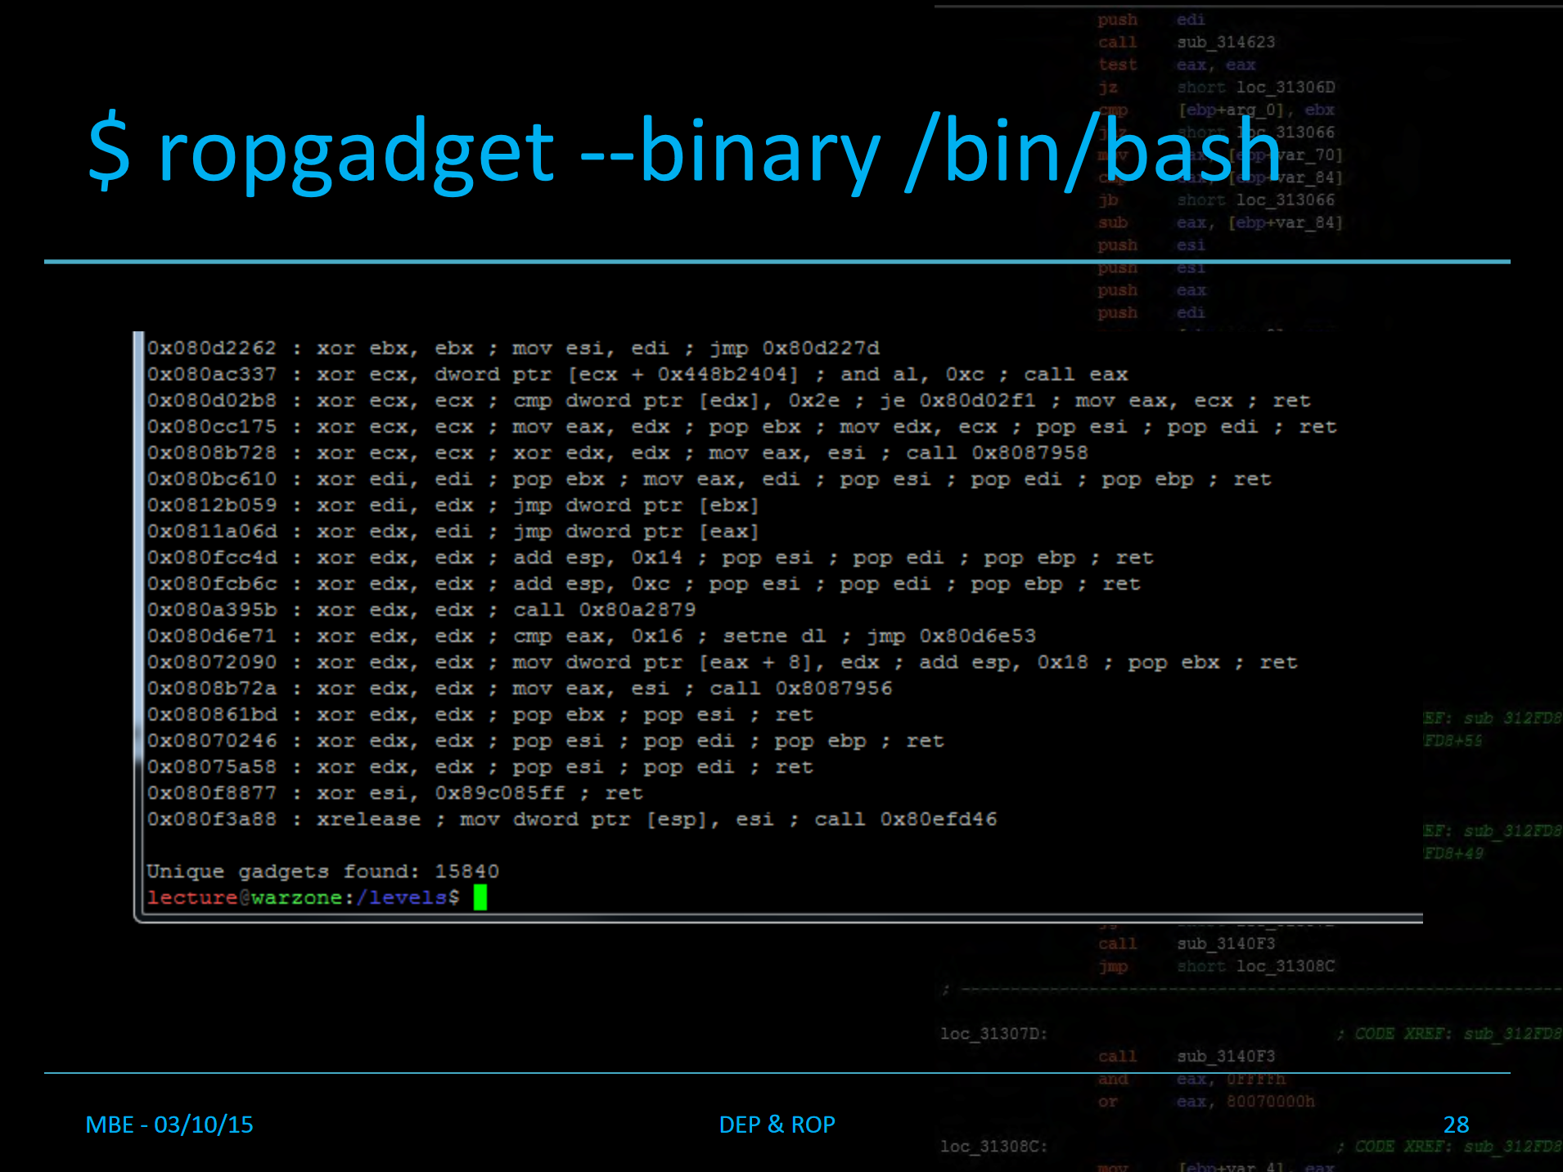

Slide 26
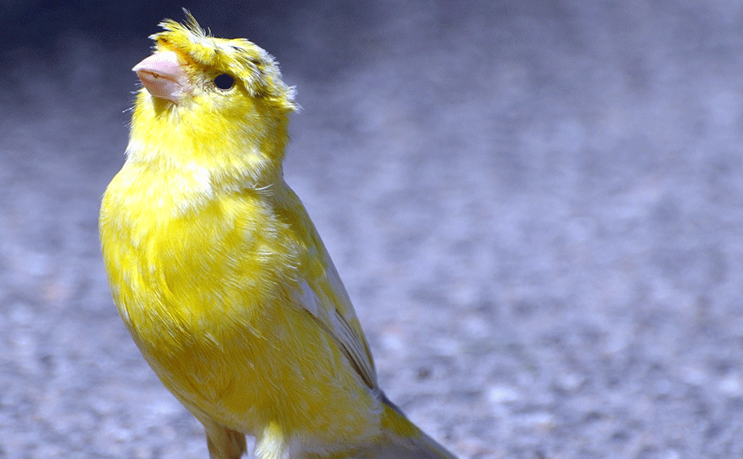
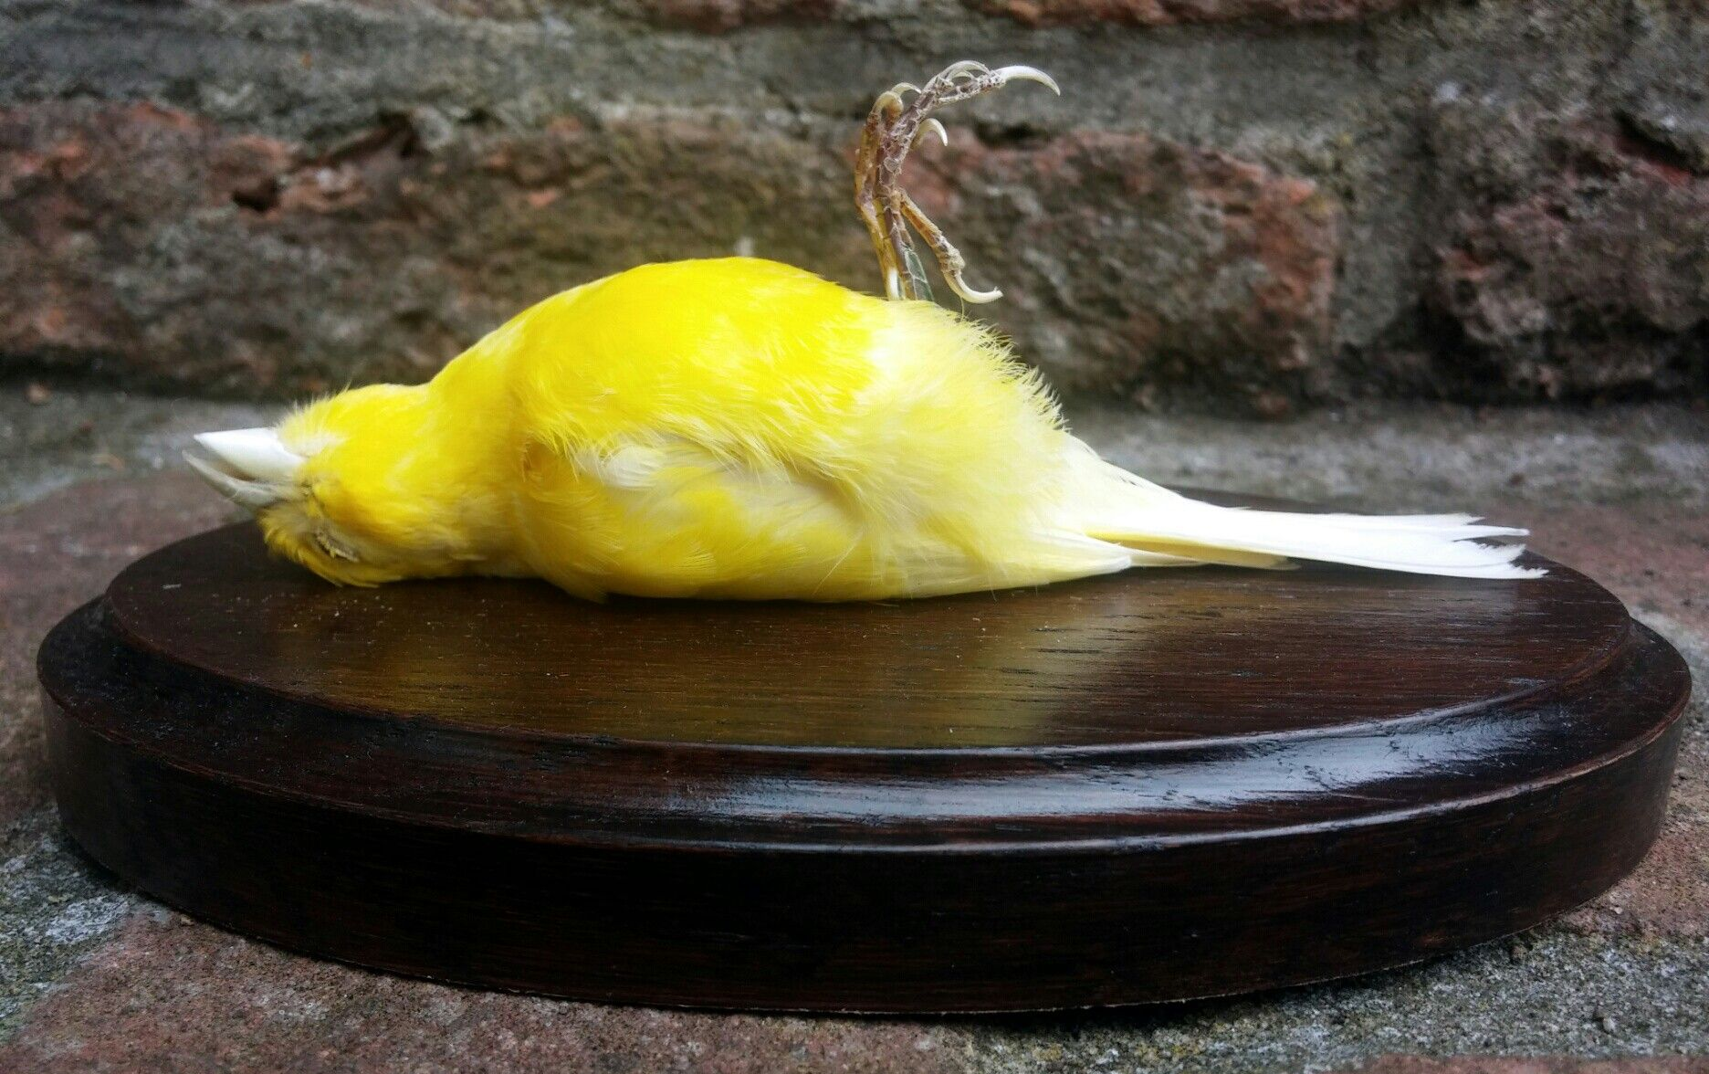
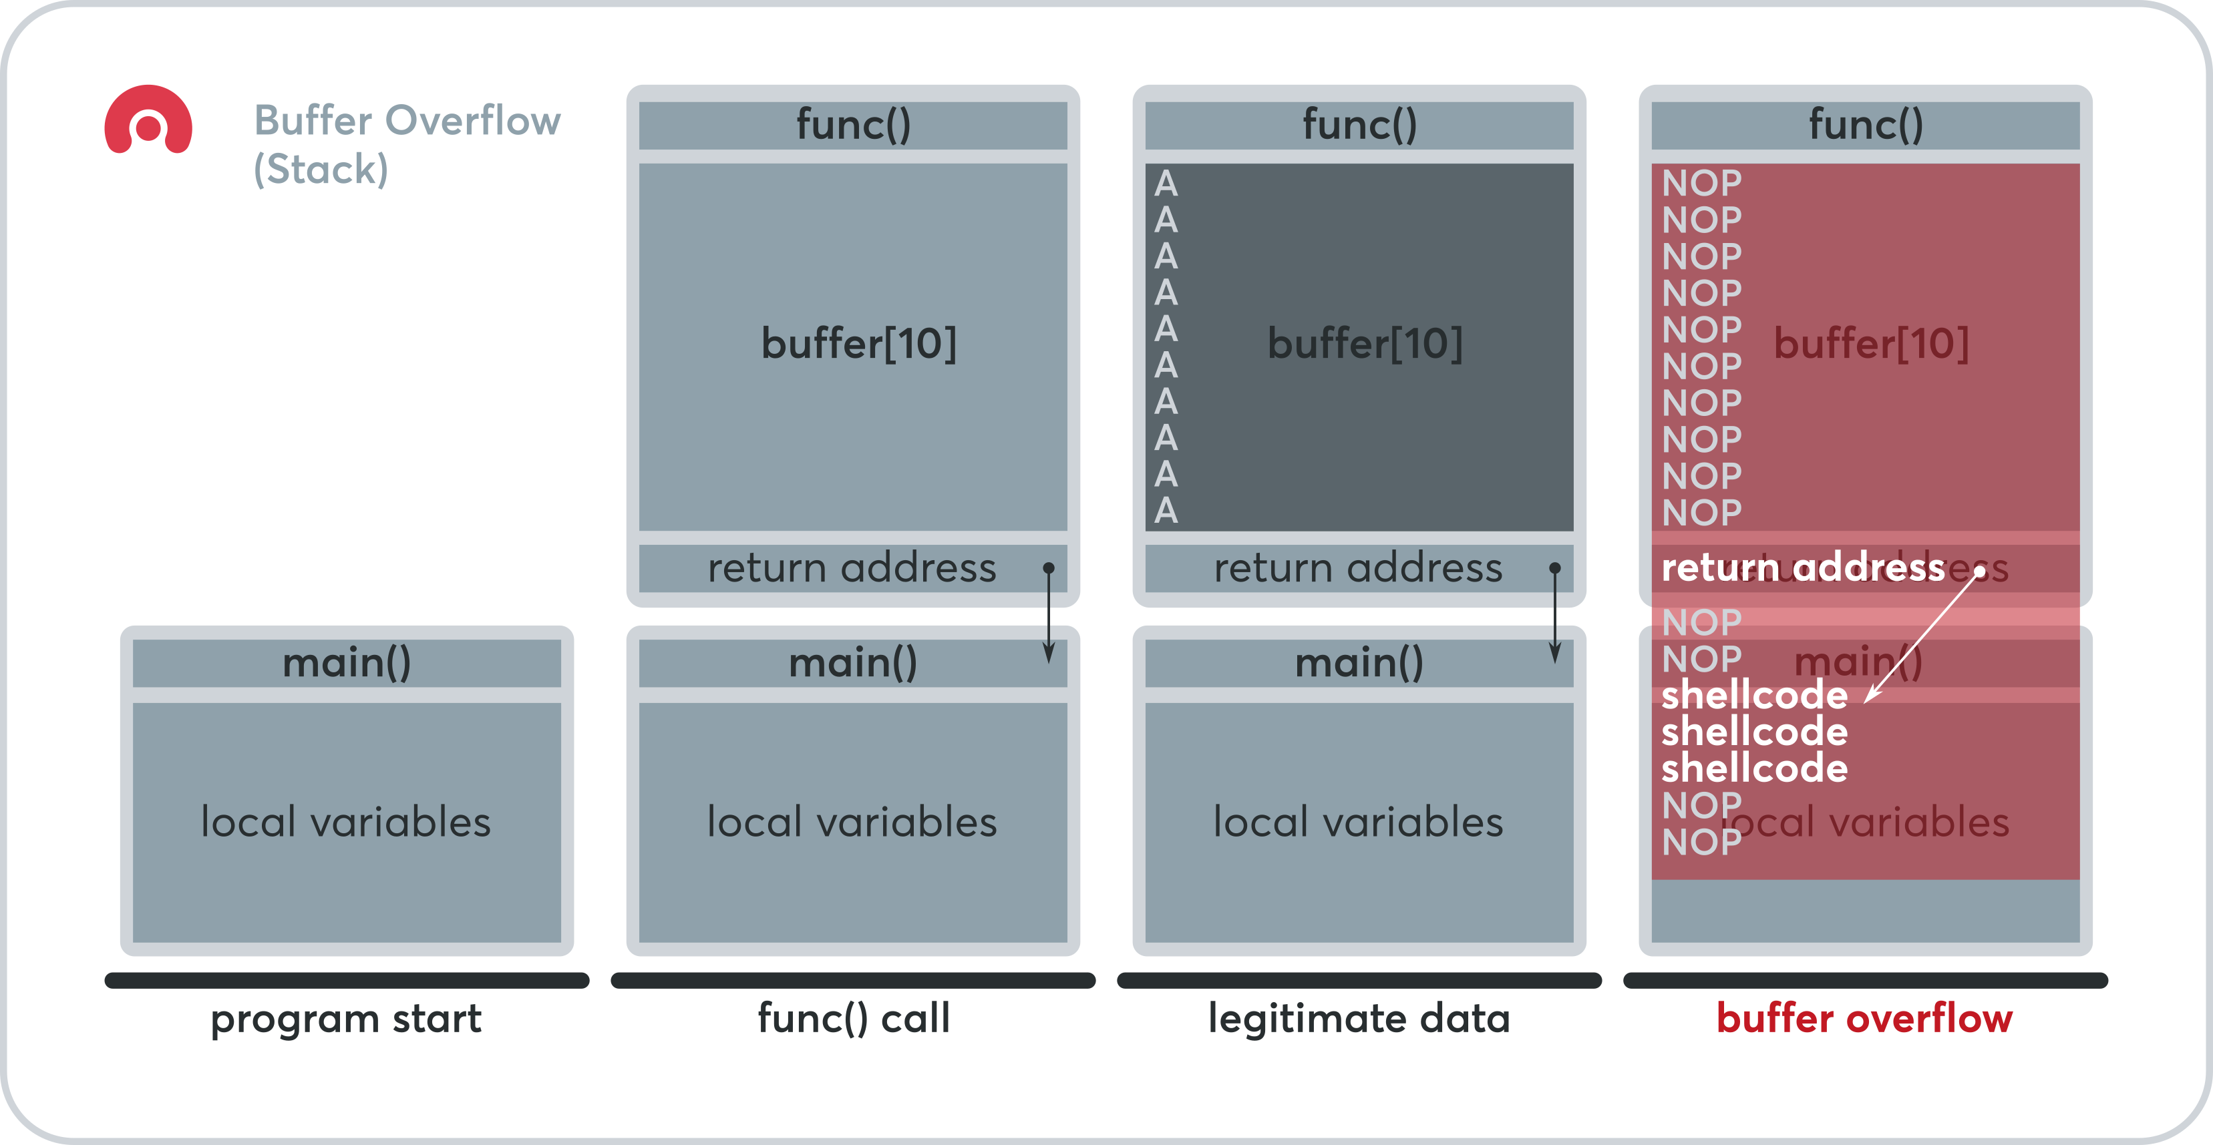
Stack Canary
rand()
stack canary
stack canary

Slide 27
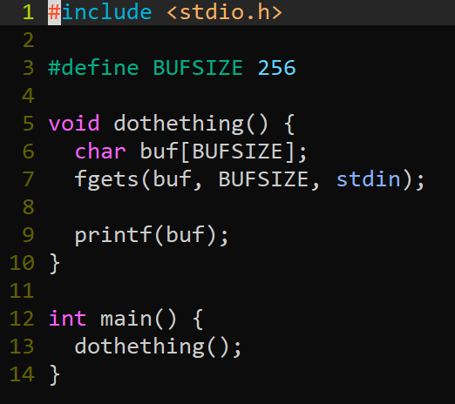
Bypassing Stack Canary

Slide 28
GOT & PLT
If we don’t know where libraries will be loaded at, how do we know the addresses of their functions?
The GOT! (Global Offset Table)
A giant table of function pointers…

Slide 29
Things to Watch Out For
Lazy Loading
RELRO

